Slide 1
Python: 3.X: Lets Learn
INTRODUCTION

Slide 2







Slide 5




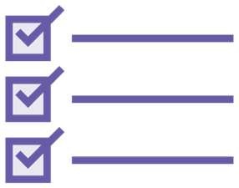

Slide 8
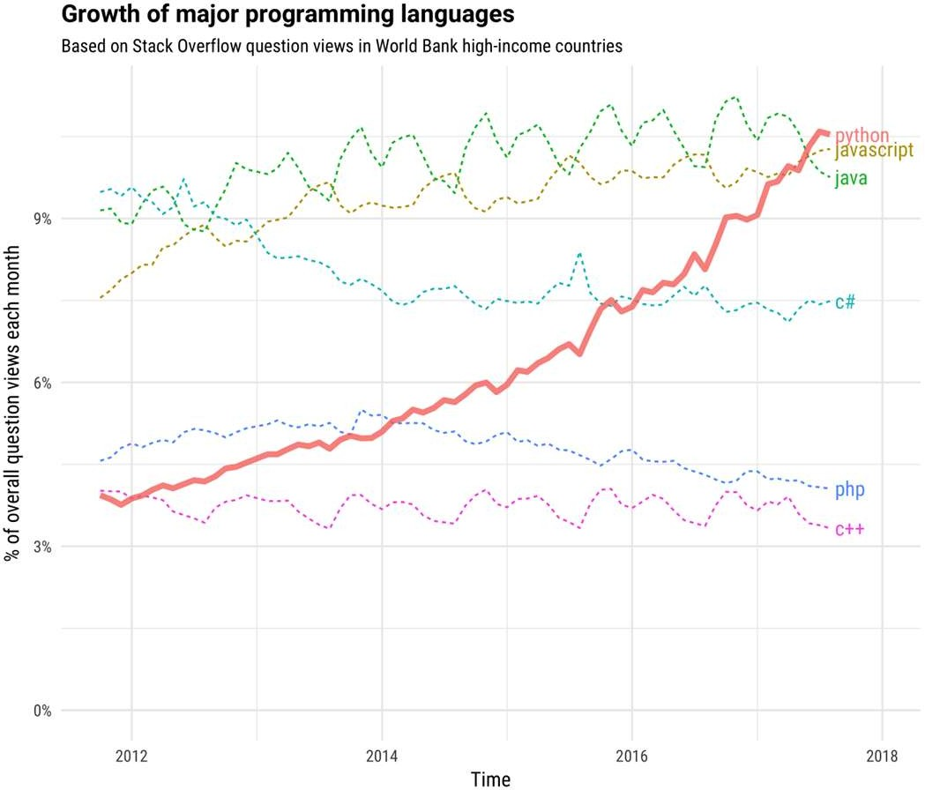
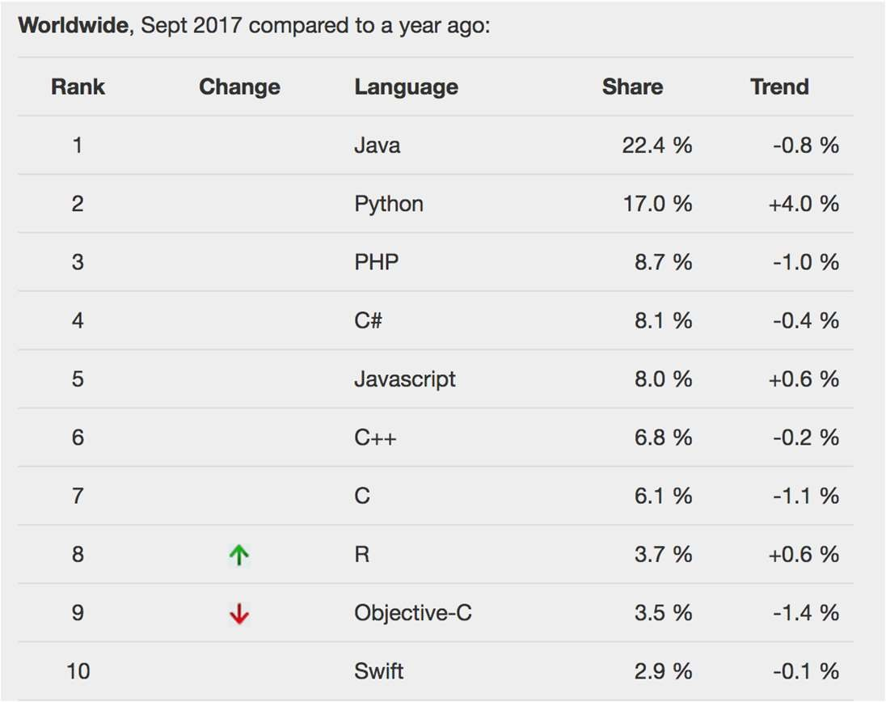

Slide 9
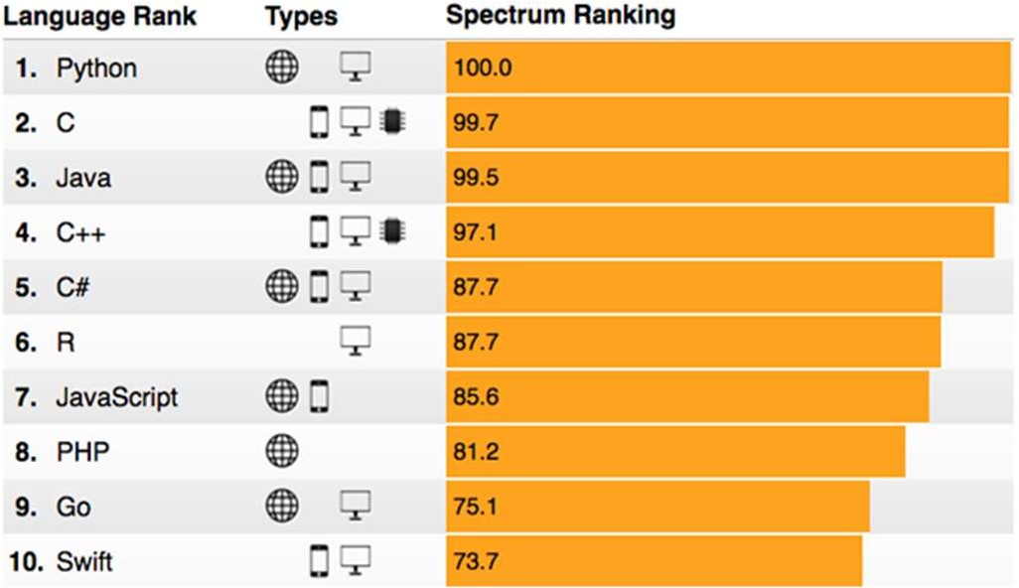
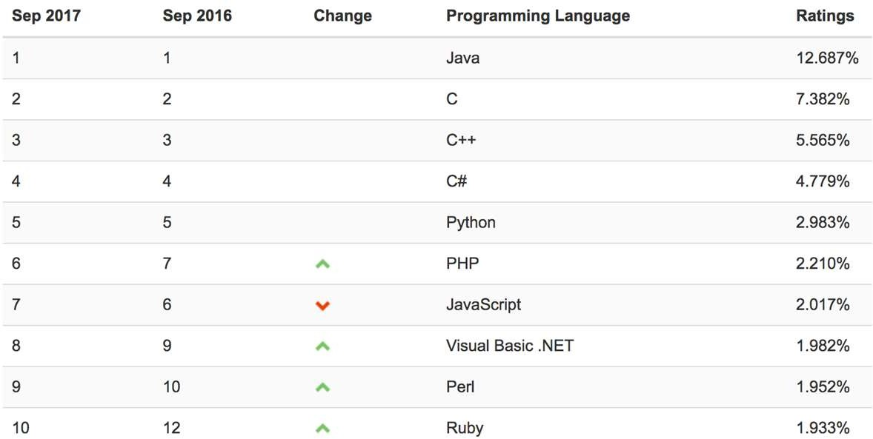

Slide 10
What Makes Python so Amazing?

Slide 11
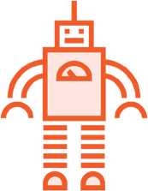





Using Python
Automation
Science
Desktop
Android
Web
Machine Learning

Slide 12
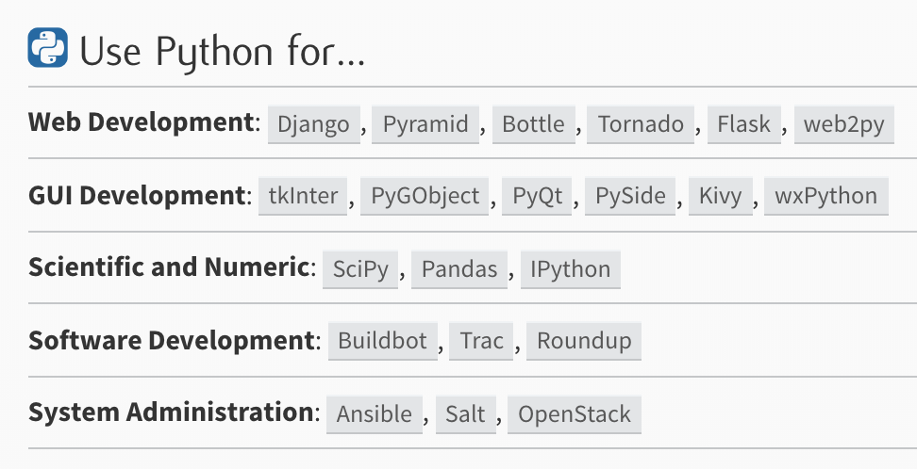

Slide 13
Python vs The Others
// Java
public class HelloWorld {
public static void main(String[] args) { System.out.println("Hello World")
}
}
# Python 3 print("Hello World")

Slide 14
Installing Python

Slide 15
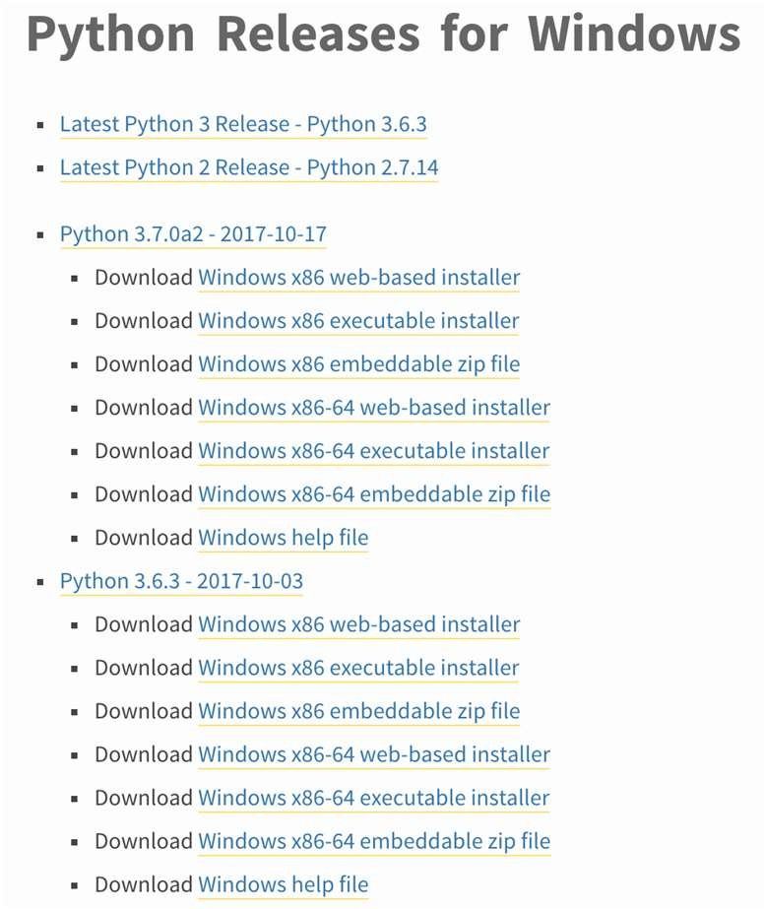
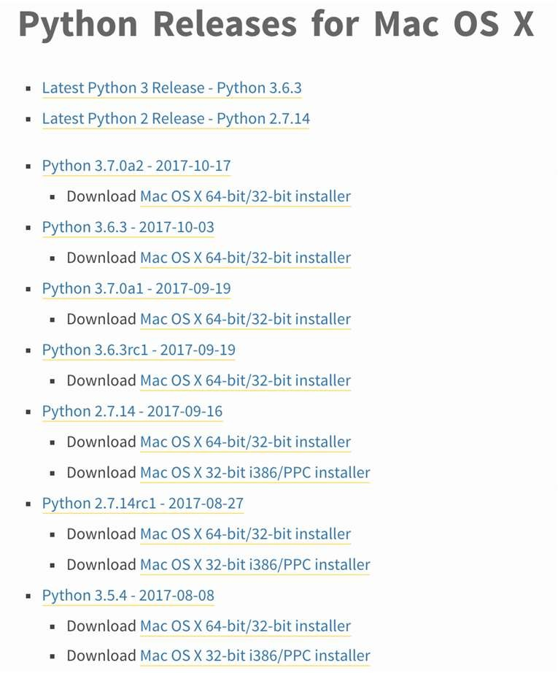

Slide 17
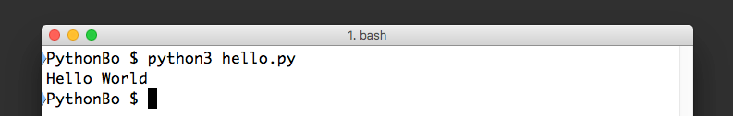
Running a Python Program
# hello.py file contents print(“Hello World”)

Slide 18
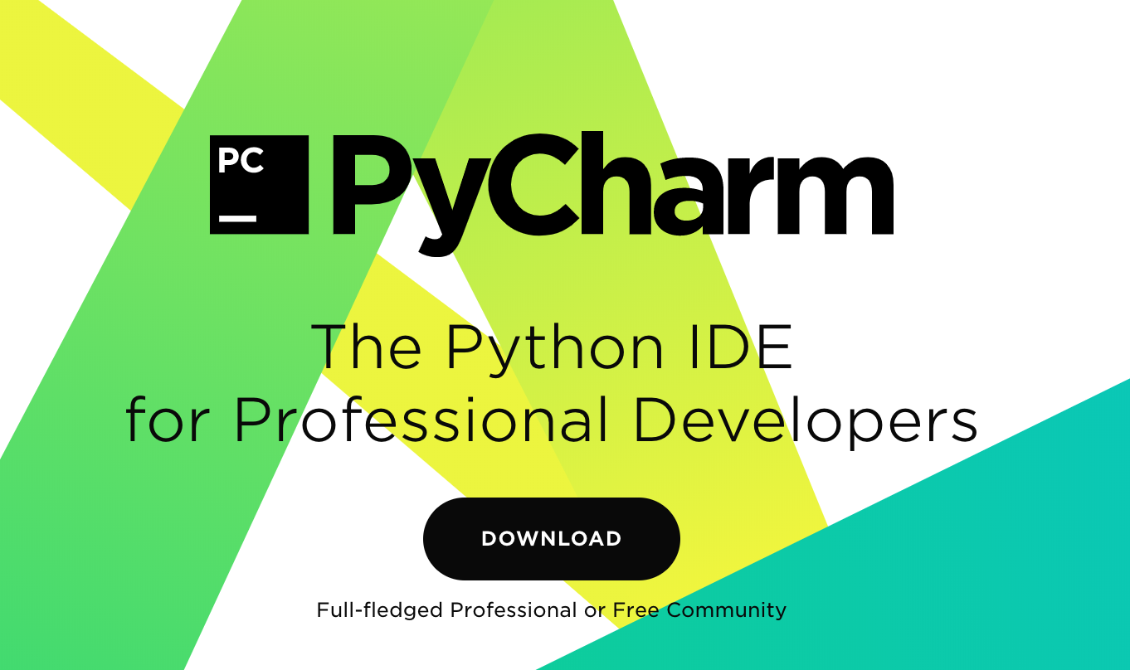
Installing PyCharm

Slide 20
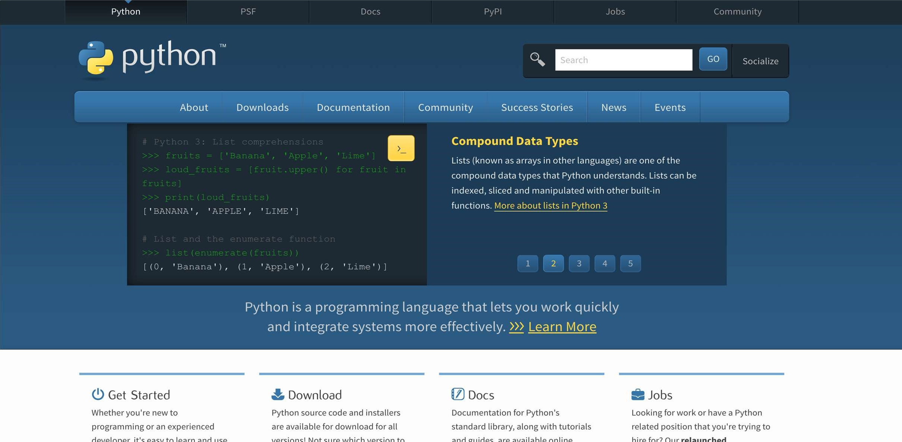

Slide 22
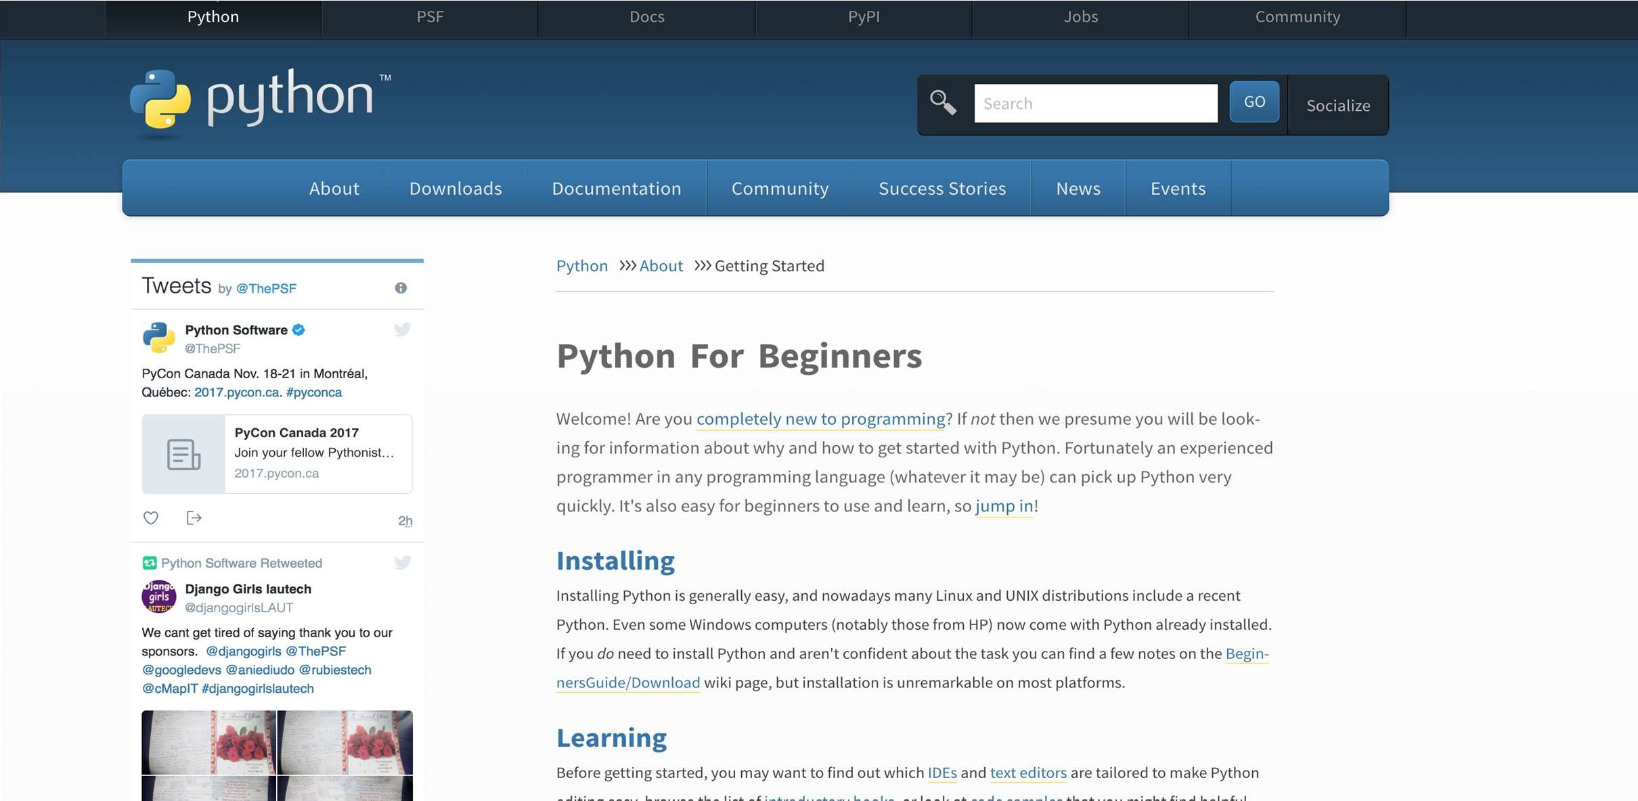

Slide 23
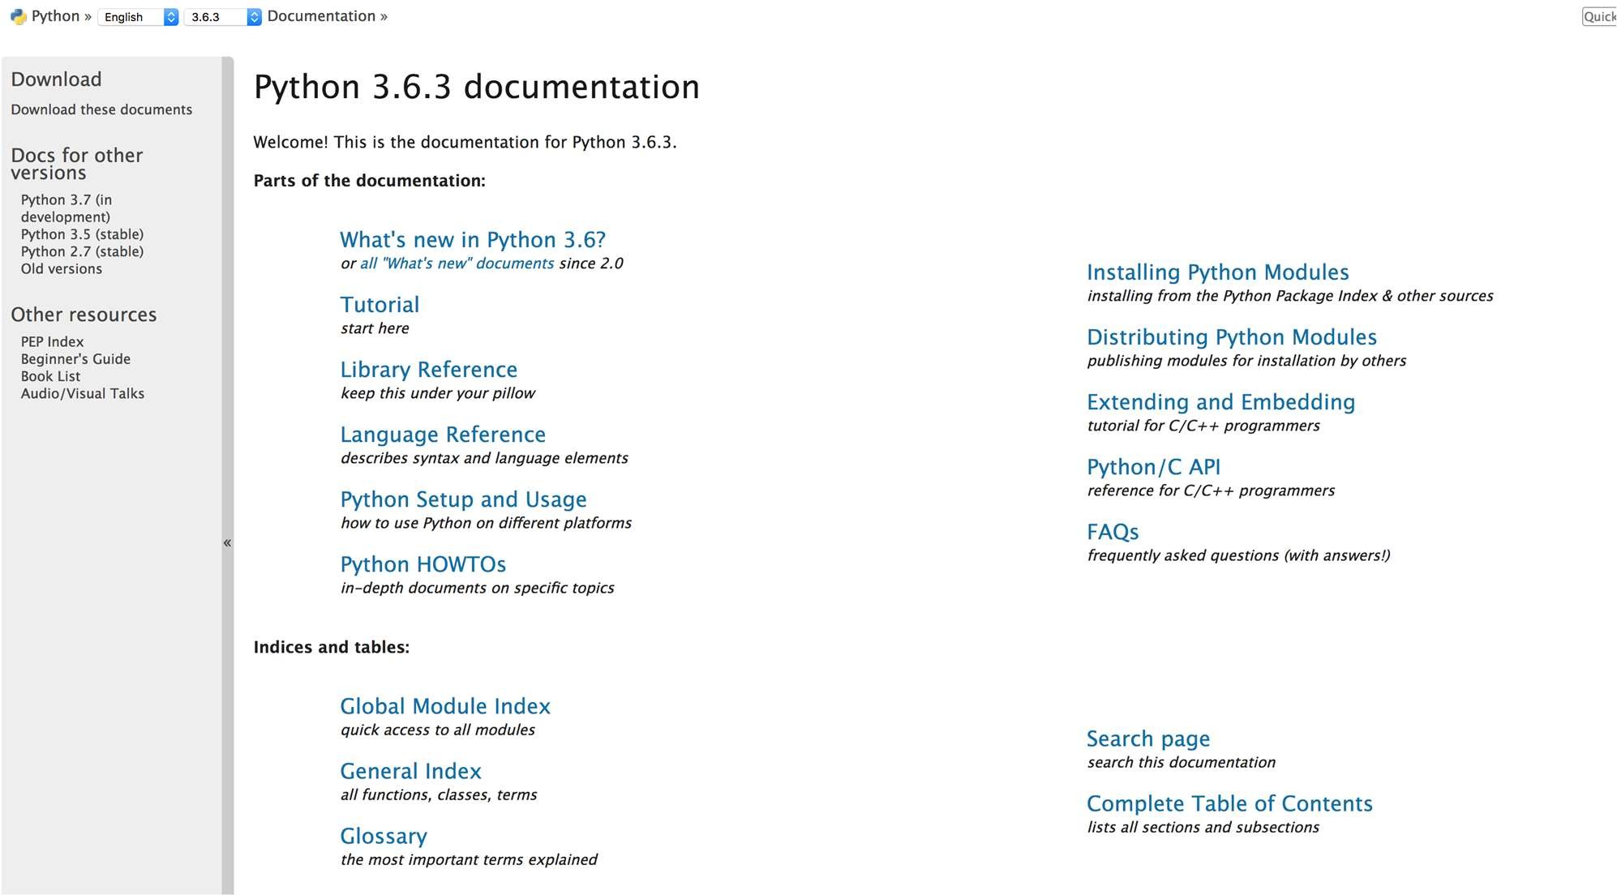

Slide 24
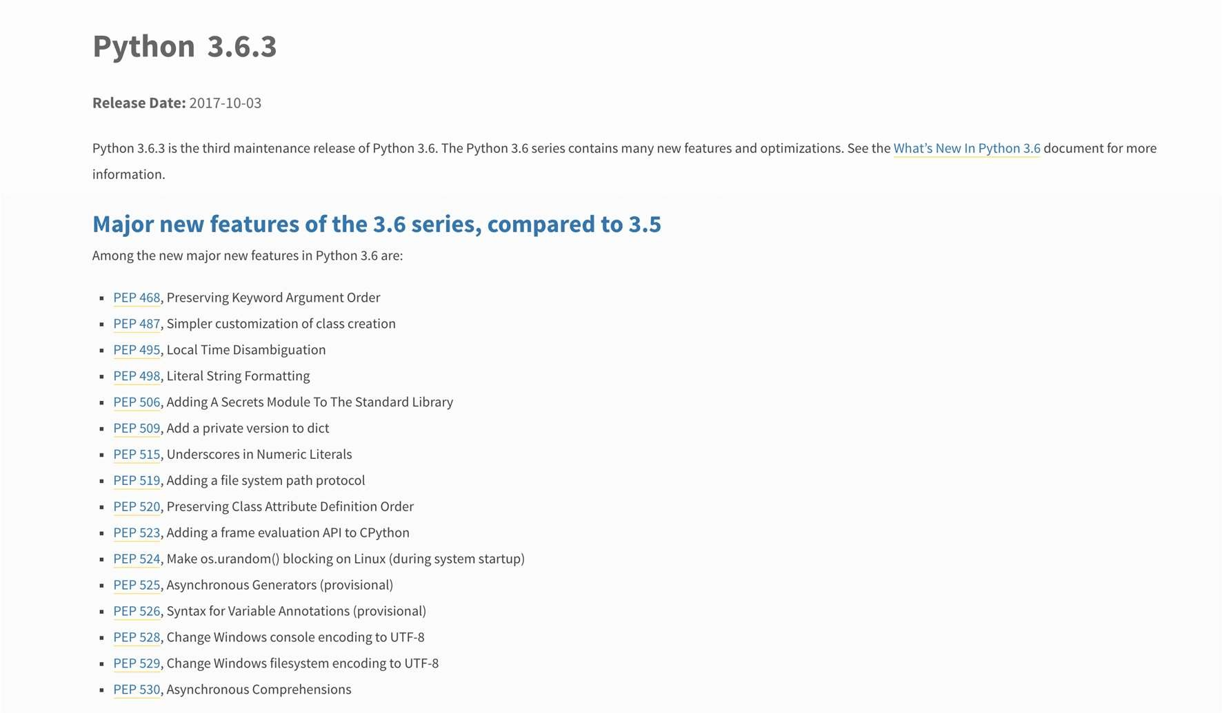

Slide 26






Slide 27


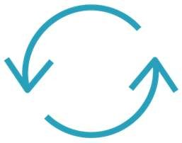

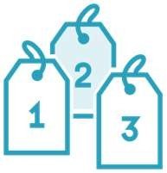


Slide 29
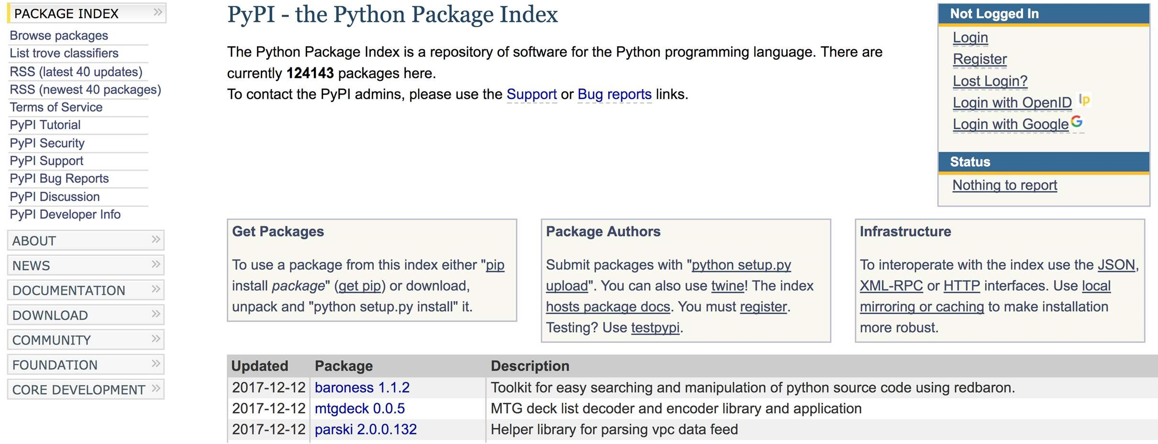

Slide 30
Python 2 vs Python 3

Slide 31
Python 2 vs Python 3
Python 2
Maintained, but no new features End of Life (EOL) in 2020 Still default on many systems print “Hello World”
Python 3
New features being added Unicode support by default Cleared some Python 2 confusion print(“Hello World”)
Minor differences from Python 2

Slide 32








Slide 33






Slide 36


